Slide 1
Large Language Models

Slide 2
Outline
Intro to LLMs
Major LLM Players
Responsible AI Usage
Cost & Token Considerations

Slide 3

LLM Intro

Slide 4
LLM Introduction
Large Language Models are a type of Generative AI training on massive amounts of text
LLMs specialize in generating human-like text to answer questions, summarize content and write code
LLMs are general-purpose tools, the same underlying model can support many different use cases, unlike traditional narrow AI systems built for one specific task.
Note: LLMs are best suited to language-based and pattern-based tasks, they are not universal replacements for deterministic systems (e.g. precise math, database lookups, mission critical calculations)
In these instances, traditional software is often still the better tool.

Slide 5
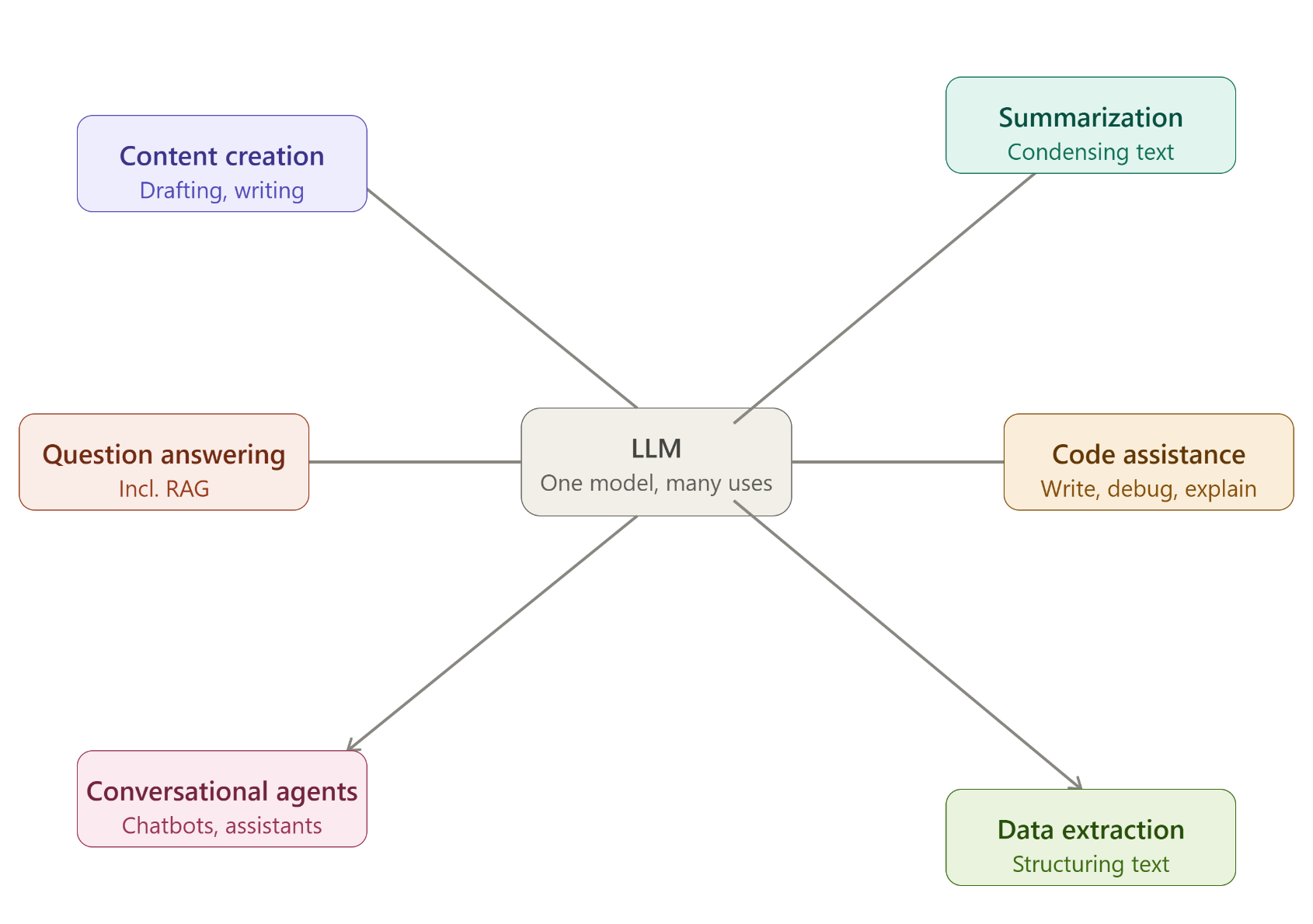
LLM Introduction

Slide 6
LLM Use Cases
Content Creation: Drafting emails, blog posts, marketing copy and other written material
Summarization: condensing long documents, meeting transcripts, shortening articles, creating digestible summaries
Question Answering: retrieving and synthesizing information in response to natural-language questions.
RAG (retrieval-augmented generation) can be used to include data from private/internal documents
Code Assistance: Writing, explaining, debugging and refactoring code
Conversational Agents: customer support chatbots, virtual assistances and other interactive tools
Translation and Language Tasks: translating text, adjusting tone/formality, grammar correction
Data Extraction and Structuring: pulling structured information (e.g. names, dates, categories) out of unstructured text, like emails or PDFs
Reasoning and Analysis: Working through multi-step problems, comparing options, analyzing data described in natural language

Slide 7
Major LLM Players

Slide 8
LLMs
LLMs are build and released by a mix of large tech companies, dedicated AI labs, and open-source communities.
No single organization “owns” the space
Note: This list is a current snapshot of some major players in the LLM and AI space.
New models, merges, rebrands and entirely new players are common in this field.
GPT (Open AI): One of the most widely recognized LLM families
Powers ChatGPT
Lineup: GPT 5.6 (Sol, Terra and Luna)
GPT 5.5

Slide 9
LLMs
BERT (Google)
One of the foundational LLM architectures.
Released in 2018
Unlike GPT-style models built for generating text, BERT was designed primarily for understanding text.
Largely replaced Gemini
Claude (Anthropic)
Anthropic’s LLM family
Organized into named tiers - Haiku, Sonnet, Opus, and Fable (as of June 2026).
Powers Claude.ai, Claude Code, and Claude Developer Platform.
Known for strong coding and agentic task performance.

Slide 10
LLMs
Llama (Meta)
Meta’s open-weight model family.
As of 2026, Meta has not released a Llama 5
The company has shifted its frontier research toward a separate, closed-weight model.
Llama is Meta’s open-weight offering for self-hosting and developer customization
Copilot (GitHub / Microsoft)
Not a model itself
A product that integrates multiple underlying LLMs (including OpenAI) directly into developer tools
Can integrate into: VS Code, Visual Studio and the CLI

Slide 11
LLMs
Codeium -> Windsurf -> Devin Desktop (Cognition):
Originally an independent coding assistant (Codeium)
Rebranded to windsurf when it became a full agentic IDE
Acquired by Cognition (maker of the Devin autonomous agent) and rebranded again to Devin Desktop in mid-2026.
As you can see, this field is constantly evolving.
Treat the underlying concepts (how LLMs work, how to evaluate them) as durable.
Product names + features are likely to shift, possibly significantly over the next 5-10 years.

Slide 12
LLM Players
Technology | Organization | Type | Key Takeaway(s)
GPT | OpenAI | Proprietary LLM | Powers Chat GPT; Frequent versioning/renaming
BERT | Google | Foundational LLM Architecture | Understanding-focused, not generation-focused
Claude | Anthropic | Proprietary LLM | Tiered naming system; Strong coding & agentic performance
Llama | Meta | Open-weight LLM | Self-hostable
Copilot | GitHub / Microsoft | Product (leverages multiple LLMs) | Integrated directly into developer tools
Codeium (Windsurf/Devin Desktop) | Cognition (formerly independent) | Product (AI coding IDE) | Rebranded twice in 2 years – showcases industry pace

Slide 13
Responsible AI Usage

Slide 14
Responsible AI Usage | Best Practices
To properly leverage LLMs and Generative AI models, it is important to keep the following techniques in mind.
Note: None of these techniques are inherently required to use LLMs, nor will they “solve” any problem for you
These techniques should be always considered and employed as needed to ensure you get the highest quality outputs

Slide 15
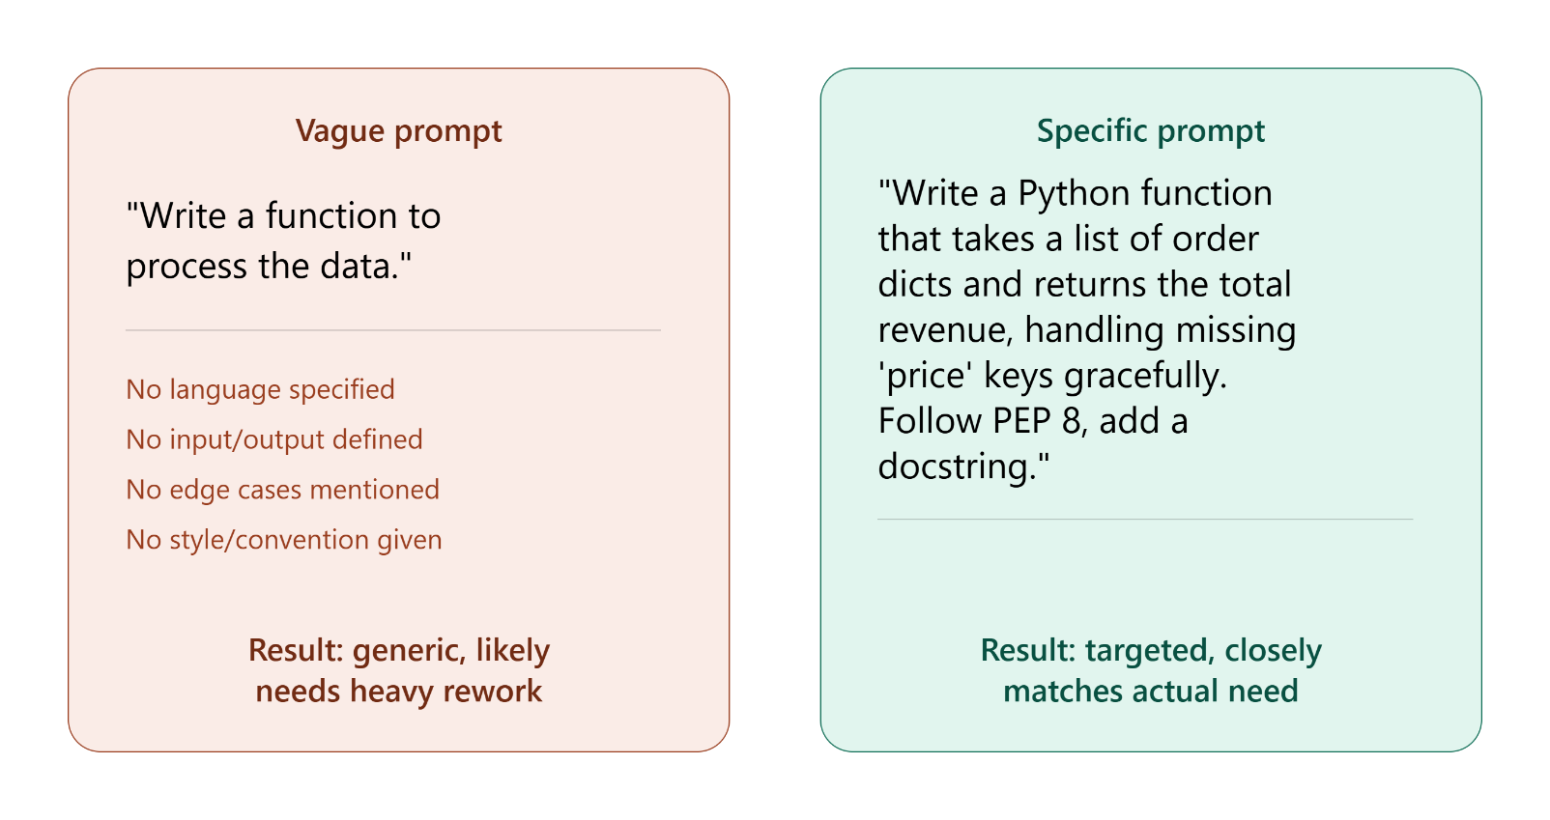
Responsible AI Usage | Best Practices
Be Clear and Specific
LLMs perform better with details, unambiguous instructions than with vague requests
Specify: format, tone, length and constraints as relevant.

Slide 16
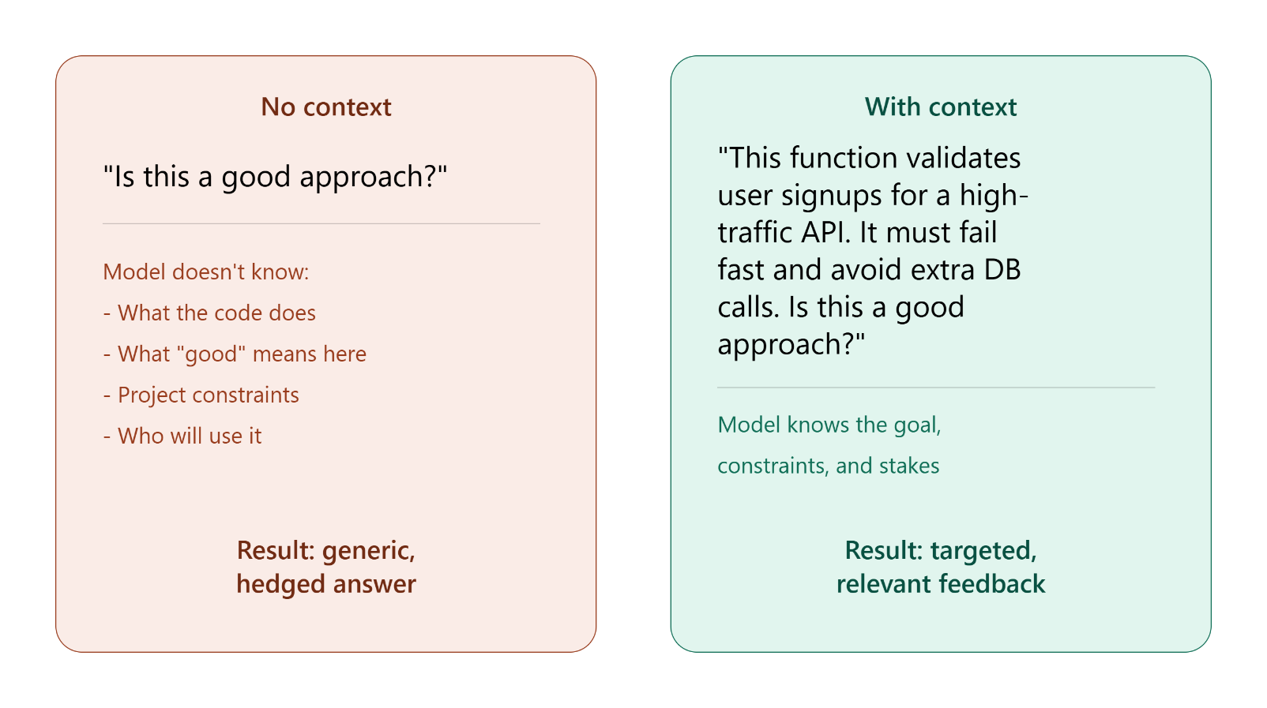
Responsible AI Usage | Best Practices
Provide Context
Give the model relevant background information (audience, goals, etc)

Slide 17
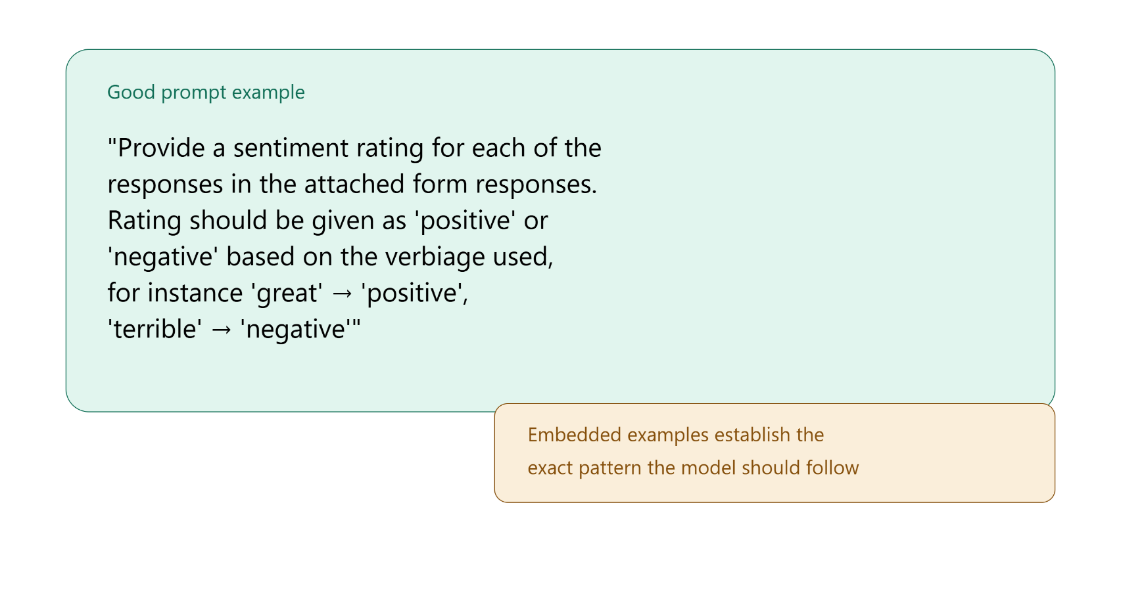
Responsible AI Usage | Best Practices
Use Examples (few-shot/multi-shot prompting)
Show the model one or more examples of input/output patterns expected.
Improves accuracy and consistency
Can provide better clarity than long-winded and detailed instructions

Slide 18
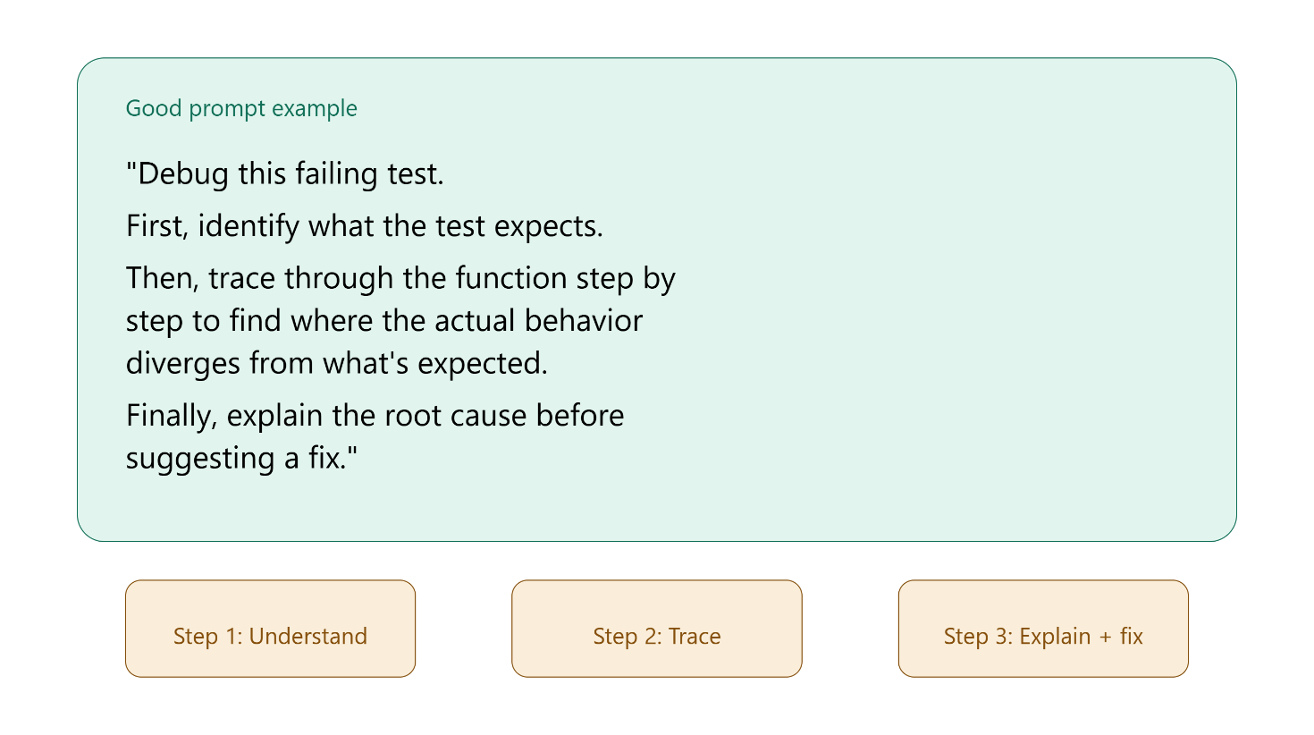
Responsible AI Usage | Best Practices
Break complex tasks into steps (Chain of thought prompting)
Ask the model to work through problems, step-by-step
Tends to produce more accurate results
Best for complex tasks

Slide 19
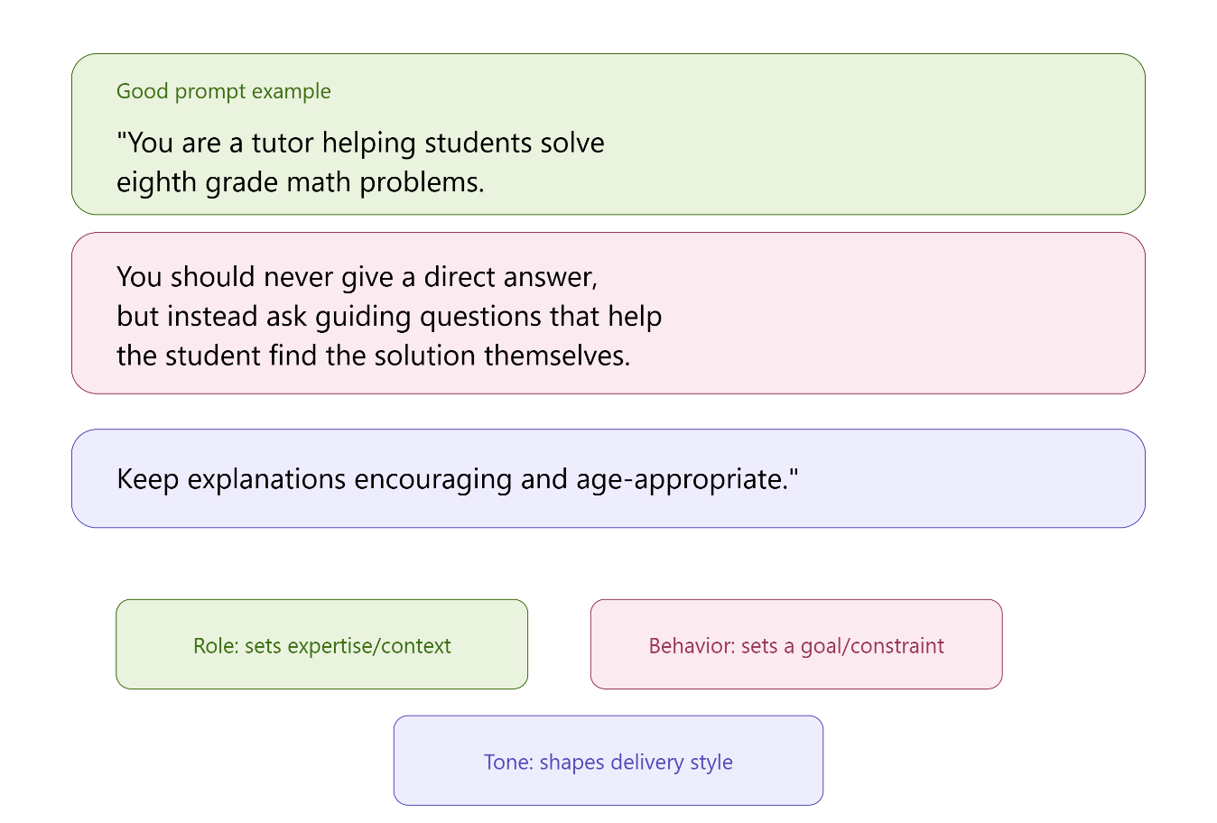
Responsible AI Usage | Best Practices
Give the model a role or persona
Can help calibrate tone and the type of feedback given
Particularly useful open-ended tasks

Slide 20
Responsible AI Usage | Best Practices
Iterate
Treat the first prompt as a draft
Refine the prompts based on the output you get
Should be considered a phase in normal workflow, not a sign that something went wrong
Be mindful of context window limits
Models can only “see” a limited amount of text at once (its context window)
Long conversations or large documents may cause earlier information to be dropped or deprioritized
Create new chats to reset current context

Slide 21
Responsible AI Usage | Best Practices
Ask LLM to cite sources
Most LLMs have some feature to search the web for relevant information
Always verify sources of information (invalid links can sometimes be cited)
Sources can be provided documents, or web searches
Always review and verify output
“Factual Claims” should be particularly scrutinized
Treat LLM output as a first draft or a knowledgeable collaborator’s suggestion
Don’t treat single response as final answer
Especially important for anything high-stakes or anything with large consequences (legal, medical, financial, security-related)
Use LLM output as a starting point for human review

Slide 22
Responsible AI Usage | Bias
Bais in an LLM refers to systematic skew in its outputs that reflects imbalances, stereotypes, or gaps present in its training data, rather than fair or accurate reasoning
Common sources of Bias:
Training Data imbalance: If certain groups, viewpoints or languages, or dialects are underrepresented in training data, model performance and fairness can suffer for those groups
Historical bias: data reflecting past human decisions (e.g. hiring records, load approvals) can encode and perpetuate historical inequities
Labeling bias: human annotators involved in training and fine-tuning can introduce their own subjective judgements into the data.
Bias can show up in subtle ways
Differing quality of responses across languages
Stereotyped assumptions in generated content
Uneven performance across demographic groups on the same task

Slide 23
Responsible AI Usage | Limitations
Limitations are distinct from bias
Inherent constraints in what an LLM can reliable do, regardless of fairness concerns
Common Limitations:
Knowledge Cutoff: A model’s training data has a fixed end date; it doesn’t automatically know about events after that point unless given external information
No True understanding: Models predict statistically likely text; they don’t “understand” concepts the way humans do. This can lead to confidently incorrect reasoning.
Inconsistency: The same prompt can sometimes produce different quality answers across attempts
Struggles with precise, multi-step logic: Especially with arithmetic, exact counting, or highly rigorous formal reasoning, without extra support
If you’re building a product using an LLM, undetected bias or unrecognized limitations can lead to real harm to users, legal/compliance risk, and reputational damage.
Mitigation is a shared responsibility across model providers and developers/teams building on top of models.
Training practices, safety testing, testing for bias, adding guardrails, human review for sensitive decisions.

Slide 24
Responsible AI Usage | Hallucinations
A Hallucination refers to an LLM generating output that is factually incorrect, fabricated, or unsupported, while still sounding confident and plausible
Common Types of Hallucinations:
Factual hallucination: Stating incorrect facts (wrong dates, statistics or details) with confidence
Fabricated sources/citations: inventing article titles, authors, studies, or URLs that don’t exist
Fabricated code/API references: generating code that calls functions, methods, or libraries that don’t exist
Sometimes referred to as “package hallucination”
Reasoning hallucination: arriving at an incorrect conclusion through flawed logic, even if individual facts used along the way were accurate
Context contradiction: generating output that contradicts information provided earlier in the same conversation
Hallucinations can look completely correct; but still fail – for instance hallucinated code can introduce bugs, security issues or silent errors if merged without review.

Slide 25
Responsible AI Usage | Hallucinations
Why do Hallucinations happen?
LLMs generate text by predicting statistically likely output based on patterns, not by looking up or verifying facts in a database. When the model doesn’t have reliable “knowledge” of something, it may still generate a fluent, confident-sounding response rather than indicating uncertainty.
Prevention and mitigation strategies
Retrieval-augmented generation (RAG): Grounding the model’s response in retrieved, verified source documents
Ask for sources, then verify: Prompting the model to cite where information came from, and independently checking that those sources actually exist and match LLM claims
Encourage uncertainty acknowledgement: prompting the model to say “I’m not sure” or flag low-confidence areas, rather than always producing a fully confident-sounding answer
Human review: Especially for factual claims, code, citations, and any high-stakes content, before it’s used or published
Cross-checking with independent tools: Running generated code, or verifying generated citation with a search engine, rather than trusting it at face value
Lower “temperature” settings: can sometimes reduce creative/fabricated output for tasks that require higher factual precision.
Temperature: allowed variance/determinism of LLM output
Lower temperature = More deterministic
Higher temperature = More variance/randomness
Lowering temperature is typically more relevant to teams building directly with the API than a typical chat usage.

Slide 26
Responsible AI Usage | Security Considerations
Using LLMs introduces security considerations distinct from traditional software risks.
Prompt injection: A malicious user embeds hidden instructions in input (e.g. in a document, webpage, or user message), designed to manipulate the model into ignoring its original instructions or leaking information
Data privacy and leakage: sensitive information (customer data, credentials, proprietary code) shared in a prompt may be logged, stored, or in some cases used to improve a provider’s models, depending on the platform and its data policies.
Insecure generated code: LLMs can generate code that is functionally correct, but has security vulnerabilities (missing validation, weak authentication, SQL injection risk) since the model is optimizing for a working solution, not necessarily a maximally secure one.
Never blindly execute LLM-generated code or commands: LLM generated code may have negative impacts you did not expect or desire. Any code, particularly anything involving system access, file deletion, network requests, or credentials should never by executed without review.

Slide 27
Responsible AI Usage | Security Considerations
Over-reliance / automation bias: Developers may unwittingly gain a tendency to trust AI-generated output more than warranted simply because it’s fast and sounds confident. This may lead to skipped security review steps.
Supply chain considerations: When integrating third-party LLM-powered tools or plugins into your workflow or product, you are extending trust to that provider's security practices as well as your own
Best Practice:
Treat LLM generated code and content the same way you’d treat a contribution from an unfamiliar, well-meaning collaborator
Useful and often high quality, but always subject to the same review, testing and security standards as any other code before it ships

Slide 28
Cost & Token Considerations

Slide 29
Tokens
Tokens are the basic unit LLMs use to process text
A token is roughly a word (or part of a word) – not a full sentence or a single character
A common rule of thumb: Roughly 750 words ~ 1000 tokens
Nearly all major LLM platforms price usage per token is split into two separate rates:
Input tokens: The cost of everything sent to the model (prompt, attached documents, conversation history
Output tokens: The cost of everything the model generates in response. Across virtually every major provider, output tokens are priced several time higher than input tokens, since generating text is more computationally expensive than reading it

Slide 30
Models
Every major platform offers a range of model size/tiers, generally trading off cost against capability and speed:
Smaller/Faster models: lowest cost, fastest response times. Best for simple, high-volume tasks, like classification, extraction or basic Q&A
Mid-tier models: Balanced cost, speed and capability; a common default for general coding and reasoning tasks.
Flagship/largest models: highest cost, typically slower, reserved for the most complex reasoning or agentic tasks
This “small/medium/large” tiering pattern hold across major platforms such as Claude, GPT and Gemini.
Exact names, prices and performance differ between them and change frequently as new models release.

Slide 31
Cost Management
Context window size affects cost indirectly: A larger context window means you can send more information, but every token sent is still billed, so longer conversations or documents cost more per request.
Some platforms also apply higher per-token rates once a prompt crosses a certain threshold
Common cost-management strategies:
Model routing: Using a cheaper, smaller model for simple tasks and reserving larger models for tasks that truly need them
Prompt caching: reusing a cached version of frequently repeated content at a reduced rate. Most major providers now offer some form of this
Batch processing: submitting non-urgent requests for asynchronous processing for a discount. Savings and services vary by provider.
Trimming context: avoiding unnecessarily long conversation histories or documents, when a shorter, summarized version would work as well.
Before starting a project, research and compare current pricing across the platforms you’re considering against the project’s expected usage and budget.
Pricing changes frequently and varies by provider – always check a platforms official costs and current pricing models before estimating project costs.

